Slide 1
MEAN login management
CS252

Slide 2
Last week
We looked at how to secure a LAMP application with a password-based scheme
Hopefully, you have looked at the PHP code and made the changes we agreed upon
Assignment 4 is due November 8th midnight
Have to submit link to working login management system incorporating these features

Slide 3
Basic password scheme
Hash function h : strings → strings
Given h(password), hard to find password
No known algorithm better than trial and error
User password stored as h(password)
When user enters password
System computes h(password)
Compares with entry in password file
No passwords stored on disk

Slide 4
Password-based authentication for nodeJS applications
Structure of a typical express-node app
Bin
Contains binary file that runs the app
Models
Contains data models as separate js files
Routes
Contains routing instructions for different landing pages
Each as a separate js file
Views
Different html/template files
Public
Contains client-side css and javascript
Node_modules
Contains modules from npm
Package.json
Lists modules from npm actually required by the application
App.js
The main application file
Includes dependencies, and sets up important middleware

Slide 5
Adding password authentication to a vanilla node app
Link to tutorial on course website
Comes with an associated github repo
Major conceptual steps
Storing user registration details in database
Comparing user inputs to database entries
Routing users based on authentication success/failure

Slide 6
User registration
Add a users model in the models directory
Fields
Email, needs to be unique and mandatory
Username, likewise
Password
Password confirmation
Export the users model so your login router can use it

Slide 7
Routing for user registration
In your routing file, add a POST route for sending input that looks like users to the server
if (req.body.email && req.body.username && req.body.password && req.body.passwordConf) {
var userData = { email: req.body.email, username: req.body.username, password: req.body.password, passwordConf: req.body.passwordConf, }
//use schema.create to insert data into the db User.create(userData, function (err, user) { if (err) { return next(err) } else { return res.redirect('/profile'); } }); }
What’s wrong with this?

Slide 8
Have to hash password before storage
Can use npm module bcrypt to do this
Edit the users model file to add a function to hash passwords before storing
UserSchema.pre('save', function (next) {
var user = this;
bcrypt.hash(user.password, 10, function (err, hash) {
if (err) {
return next(err);
}
user.password = hash;
next();
})
});

Slide 9
Logging people in
Two steps needed
Setting up a login route
Setting up sessions for authenticated users
Login route is simple to set up in routing file
router.get('/profile', function (req, res, next) {
User.findById(req.session.userId)
.exec(function (error, user) {
if (error) {
return next(error);
} else {
if (user === null) {
var err = new Error(‘Fail');
err.status = 400;
return next(err);
} else {
return res.send('<p>Logged in <p>')
}
}
});
});

Slide 10
Session management
Express can help – use the prebuilt session package
Add to main app.js file
Store the user ID from mongo in the req.session.userId variable in the POST route to associate all future sessions for this user with this ID

Slide 11
Login authentication
Have to define authentication protocol as part of data model, in users model file
UserSchema.statics.authenticate = function (email, password, callback) {
User.findOne({ email: email })
.exec(function (err, user) {
if (err) {
return callback(err) }
else if (!user) {
var err = new Error('User not found.'); err.status = 401; return callback(err);
}
bcrypt.compare(password, user.password, function (err, result) {
if (result === true) {
return callback(null, user); }
else {
return callback(); }
}) }); }

Slide 12
Login authentication
Have to define authentication protocol as part of data model, in users model file
(middleware that returns a function that listens for requests)
UserSchema.statics.authenticate = function (email, password, callback) {
User.findOne({ email: email })
.exec(function (err, user) {
if (err) {
return callback(err) }
else if (!user) {
var err = new Error('User not found.'); err.status = 401; return callback(err);
}
bcrypt.compare(password, user.password, function (err, result) {
if (result === true) {
return callback(null, user); }
else {
return callback(); }
}) }); }

Slide 13
Protecting pages
Define a function that checks for the presence of valid session and userID in the incoming request in your routing file
For protecting pages, pass this function as a parameter in the GET request in the router

Slide 14
Missing from this demo
Password reset
How would you implement it?
Remember the same precautions we discussed last week for security hold here too
Missing rate limits
How would you implement it?
Protection against XSS attacks
Is this system vulnerable?

Slide 15
Third-party authentication
Designing a solid and secure authentication system is hard
All it takes is one forgetful error, and your entire database is compromised
Easier to profit from others’ hard work
Third-party authentication systems
Open authorization protocols

Slide 16
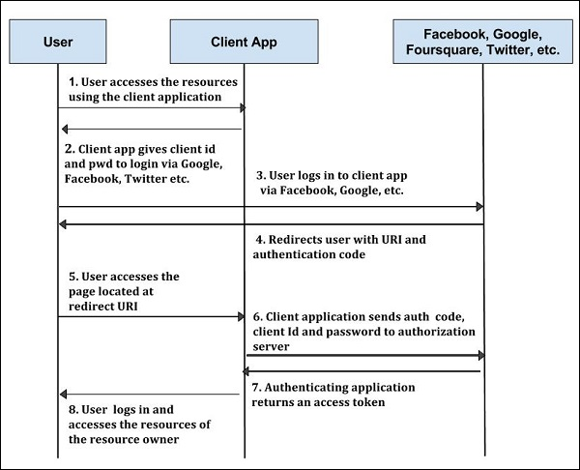
OpenAuth2.0
Use third party authorization servers to authenticate users who want to use your app

Slide 17
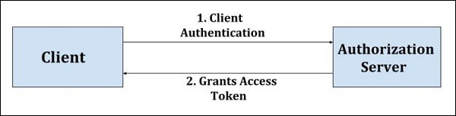
Service architecture
You register your app with third party authorization service
Client accesses third party authorization service with third party credentials
Third party grants an access token that your app recognizes
No new login credentials needed

Slide 18
Next week in lab
We will design a login management system using Passport.js
Conceptually the same as what we’ve seen today, but with more robust application support
Link to tutorial and corresponding github repo on course website
We will reshape the login management system to log people in using FB/Twitter
Might be the best model for your project apps
Link to tutorial and corresponding github repo on course website

Slide 19
Logistics
Wednesday batch will go to lab this Saturday (Nov 3rd) in lieu of Nov 7th
Projects should be substantively finished by Nov 10th
Last week of course
We will meet in RM101 on Monday and Wednesday from 1400-1600
Attendance will be taken, as for all lab sessions
Monday batch will demo their apps on Monday
Wednesday batch will demo their apps on Wednesday
No class on 15th November
End sem in DOAA end sem slot (Nov 28th, 1600-1900)

Slide 20
App demo logistics
You will make a 5-7 minute video of your app
Point out all salient features and views
Show it in action
Point out pieces of code that were hard to execute
Need not have accompanying commentary
You will have the option to talk over the visuals during the demo
Host the video on YouTube/other web sources and send me the link before the presentation
There will be external examiners, who will be free to ask questions about any aspect of the app to any member of the team

Slide 21
End sem pointers
I will try to make it non-trivial
If you have worked on all the assignments yourself, you will have no trouble
If you have looked at others’ code, or had stuff explained to you, you will have trouble
Will provide separation for grading
Closed book, closed notes
Likely 90 minute exam

